Slide 1
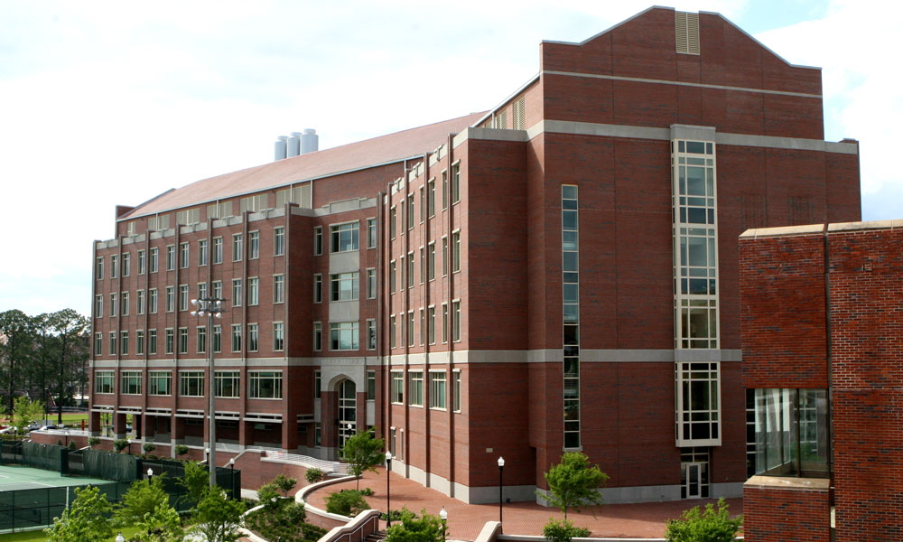
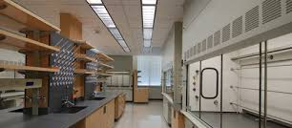
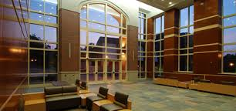
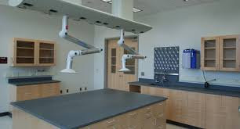
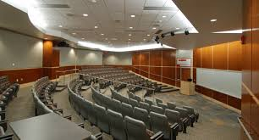
Graduate School Demystified
Ken Hanson
FSU Department of Chemistry & Biochemistry

Slide 2
Graduate School Demystified: Outline
1) Application timeline
2) Deciding where to apply
3) The application/admission process
4) Graduate school timeline
5) Graduate school summary
6) After your Ph.D.

Slide 3
Applying for Graduate School in Chemistry
Dec 1-15: Application Deadline
Transcript
CV/Resume
3 letters of rec
Cover letter
GRE (some schools)
Late Dec-Feb: Admissions
Feb and Mar: Visitation Weekends
April 15th: Decision Deadline
Early August: Start Date

Slide 4
Where to Apply?
Location
Salary
Department
Resources
Research

Slide 5
Where to Apply?
Location
- Weather
- Proximity to home
- Hobbies
- Life experience
(Note that grad school is temporary!)

Slide 6
Where to Apply?
Salary
Base Pay: $19,000-$40,000
Average: $26,500 (C&EN 2022)
FSU: $27,000
Other factors:
Tuition, fees, health insurance, guaranteed support
Cost of living (https://www.nerdwallet.com/cost-of-living-calculator)

Slide 7
Where to Apply?
Department
Size
https://www.acs.org/education/students/graduate/survey-of-phd-programs-in-chemistry.html
FSU Chemistry:
- 33 research active faculty
- ~160 graduate students
- ~40 postdoctoral fellows

Slide 8
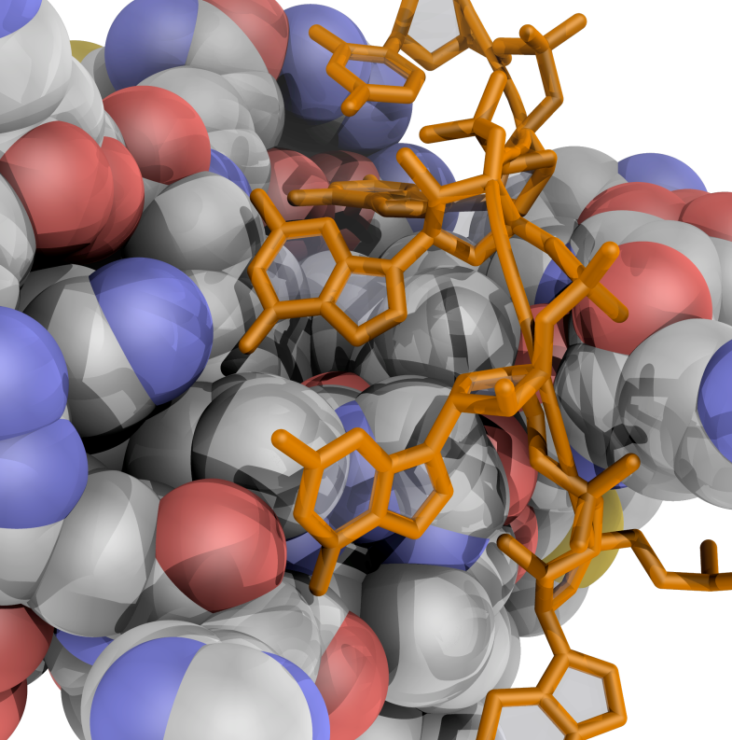
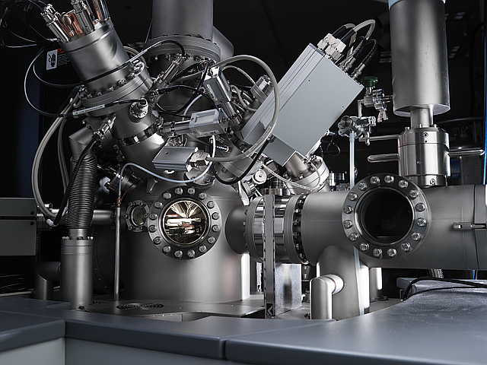
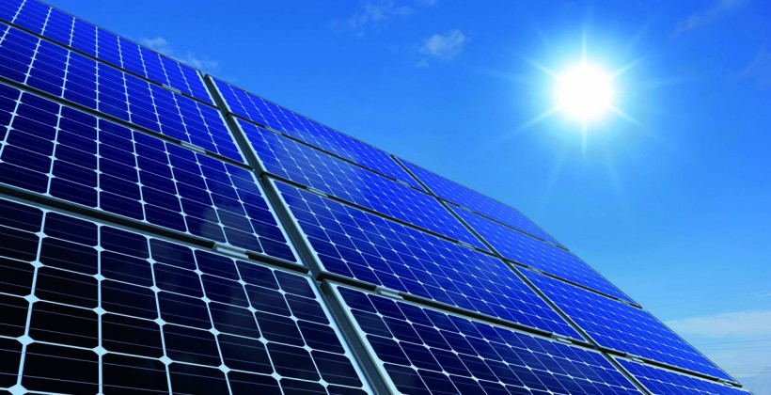
Where to Apply?
Department
Size
Research Strengths
Biochemistry Organic, Physical
Chemistry of Health
Advanced Measurement
& Analysis
Chemistry of Energy & Materials
Inorganic, Organic
Physical, Materials
Physical
Analytical
Biochemistry

Slide 9
Where to Apply?
Department
Size
Research Strengths
Collegiality
Social/Networking
Success rates
Graduate Student Union

Slide 10
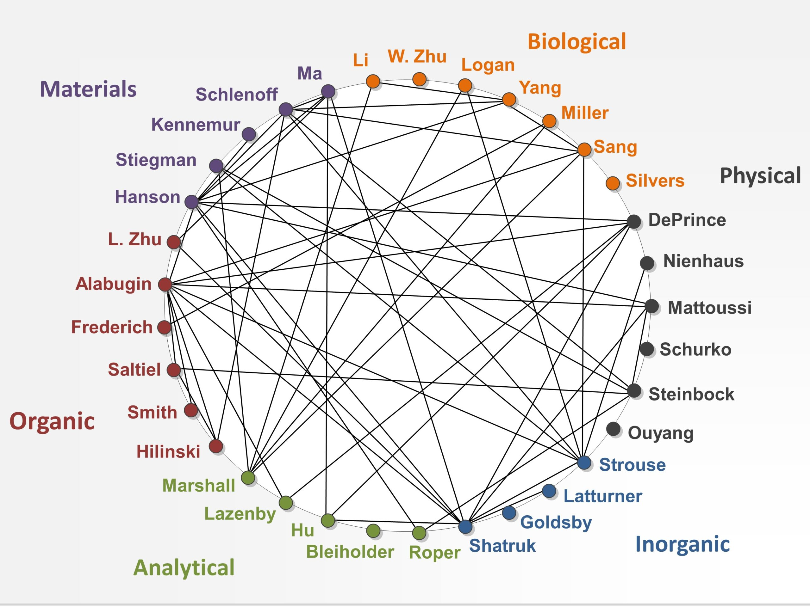
Where to Apply?
Department
Size
Research Strengths
Collegiality
Social/Networking
Success rates
Graduate Student Union
Collaborative vs. Competitive

Slide 11
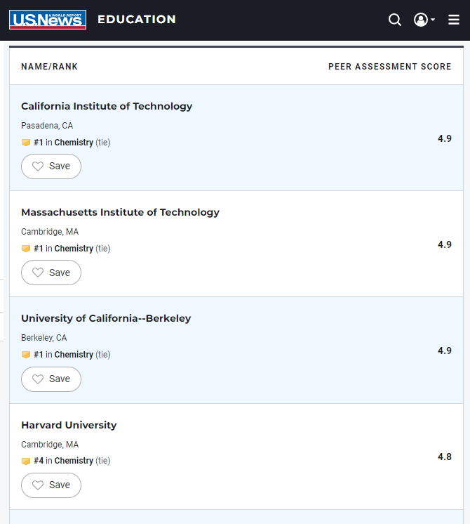
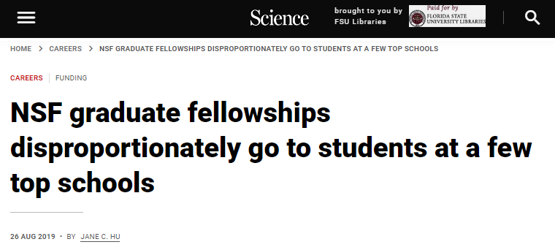
Where to Apply?
Department
Size
Research Strengths
Collegiality
Social/Networking
Success rates
Graduate Student Union
Collaborative vs. Competitive
Ranking

Slide 12
Where to Apply?
Resources
- Equipment
- Access
- Support staff
- Repairs

Slide 13
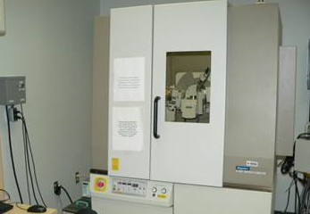
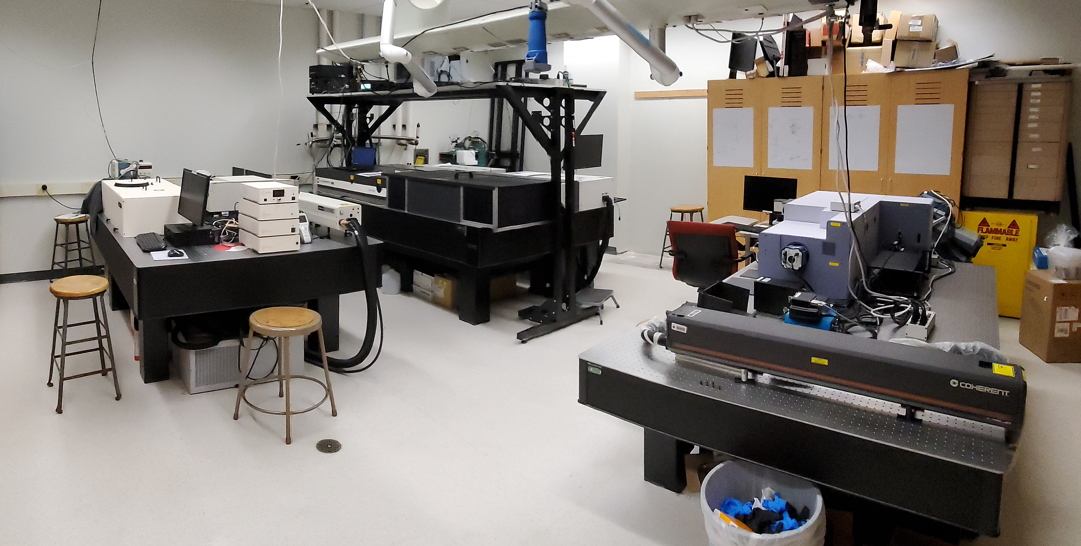
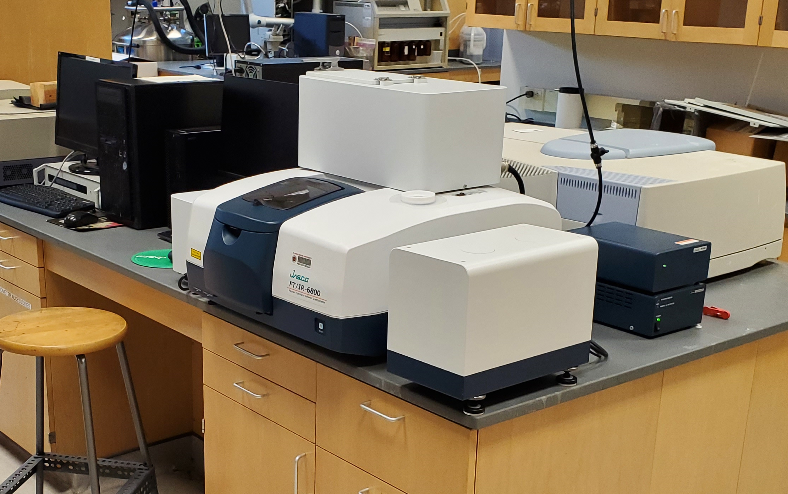
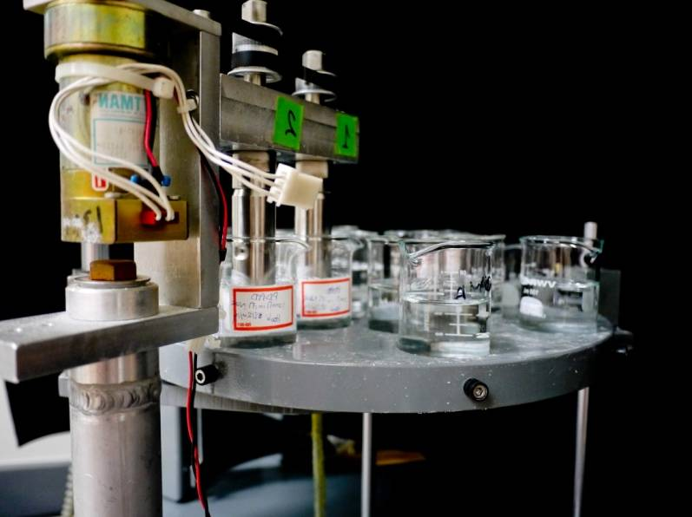
NMR Lab: Solid-State and Solution NMR 700, 600, 2 x 500, 400 and 2 x 300 MHz
MaC Lab: AFM, DSC, TGA, SQUID, BET
Mass Spec Lab: TOF, MALDI, GC, ICP, LC
X-Ray Lab: 3 x powder, 2 x Crystal, Fluorescence
Spectroscopy Lab: SS and TR spectroscopy, quantum yield, Raman/IR
Glass Blower, Machine, and Electrical Shop

Slide 14
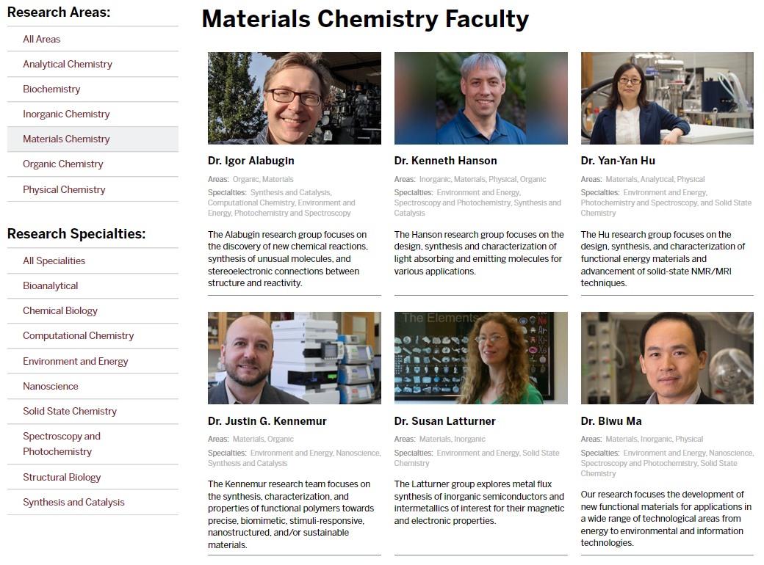
Where to Apply?
Research
Find at least two faculty that you would be excited to work with!

Slide 15
Where to Apply?
Location
Salary
Department
Resources
Research

Slide 16
Applying for Graduate School in Chemistry
Dec 1-15: Application Deadline
Transcript
CV/Resume
3 letters of rec
Cover letter
GRE (some schools)
Late Dec-Feb: Admissions
Feb and Mar: Visitation Weekends
April 15th: Decision Deadline
Early August: Start Date

Slide 17
Applying for Graduate School in Chemistry
Dec 1-15: Application Deadline
Transcript
CV/Resume
3 letters of rec
Cover letter
GRE (some schools)
Lower-level vs. upper-level GPA
Check for minimum GPA
Highlight research experience
Publications
Ideally people that know you well
From research advisor
Faculty/research interests
Address any shortcoming in your app
Less and less common

Slide 18
Applying for Graduate School in Chemistry
Dec 1-15: Application Deadline
Transcript
CV/Resume
3 letters of rec
Cover letter
GRE (some schools)
Late Dec-Feb: Admissions
Feb and Mar: Visitation Weekends
April 15th: Decision Deadline
Early August: Start Date

Slide 19
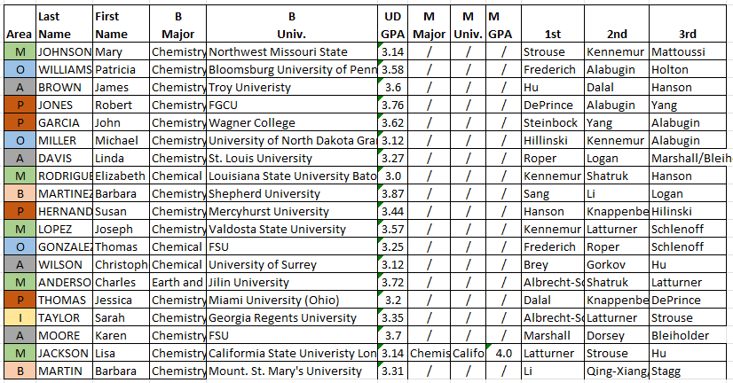
Applying for Graduate School in Chemistry
Late Dec-Feb: Admissions
Graduate Admissions Committee (6 members)
Then you get an unofficial admissions email and/or phone call!

Slide 20
Applying for Graduate School in Chemistry
Dec 1-15: Application Deadline
Transcript
CV/Resume
3 letters of rec
Cover letter
GRE (some schools)
Late Dec-Feb: Admissions
Feb and Mar: Visitation Weekends
April 15th: Decision Deadline
Early August: Start Date

Slide 21
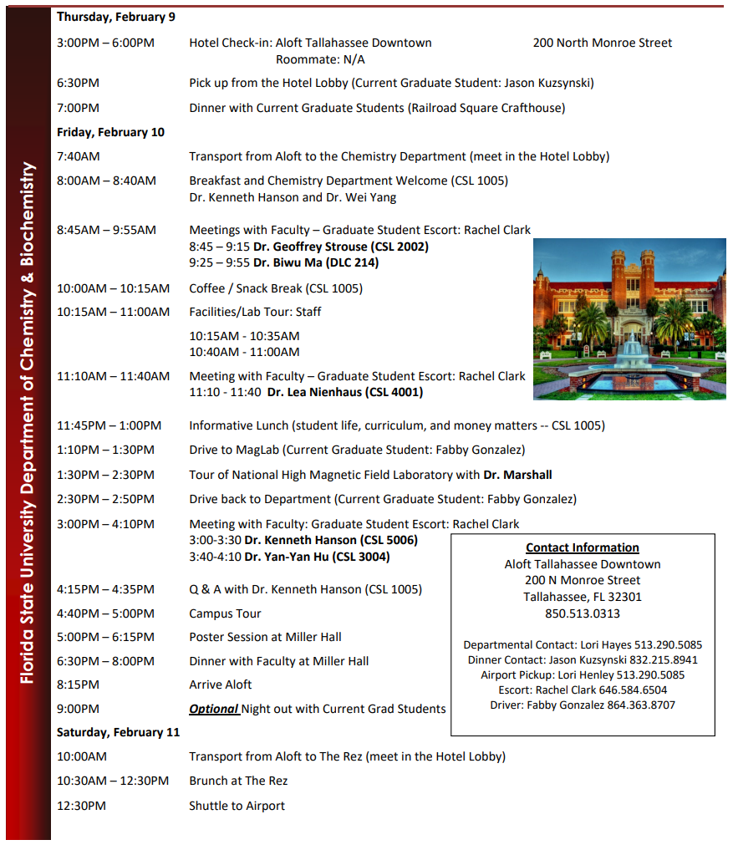
Applying for Graduate School in Chemistry
Feb and Mar: Visitation Weekend
General Goals:
Experience the town/university.
Get a feel for the department culture.
Get your questions answered.
Research goal is to find:
1) someone you want to work for.
2) a group you want to work with.
3) project/goal alignment.
4) something you would like to do on a daily basis.

Slide 22
Applying for Graduate School in Chemistry
Dec 1-15: Application Deadline
Transcript
CV/Resume
3 letters of rec
Cover letter
GRE (some schools)
Late Dec-Feb: Admissions
Feb and Mar: Visitation Weekends
April 15th: Decision Deadline
Early August: Start Date

Slide 23
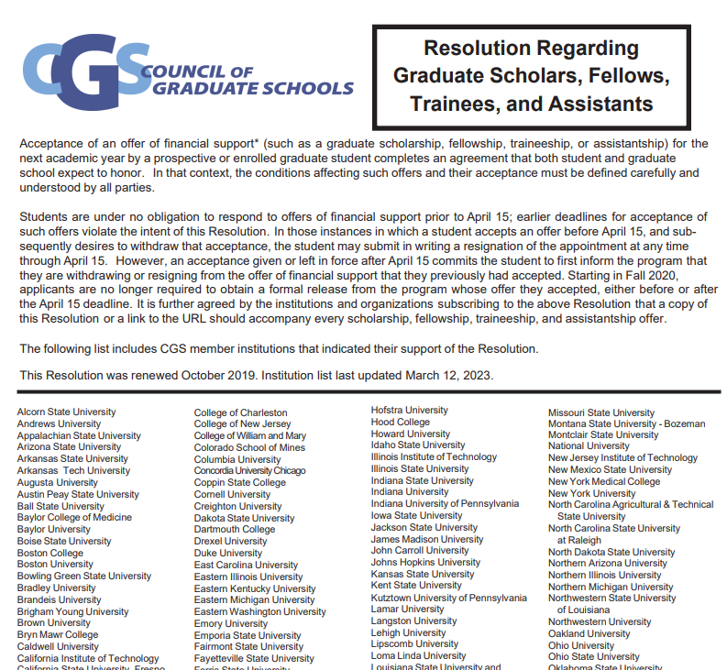
Applying for Graduate School in Chemistry
April 15th: Decision Deadline
“Students are under no obligation to respond to offers of financial support prior to April 15”
“[If a person accepts on offer but wants to change] the applicant must first inform the program that they are withdrawing or resigning from…Once they have informed the program that they are withdrawing, they then can accept any other offers.”

Slide 24
Applying for Graduate School in Chemistry
Dec 1-15: Application Deadline
Transcript
CV/Resume
3 letters of rec
Cover letter
GRE (some schools)
Late Dec-Feb: Admissions
Feb and Mar: Visitation Weekends
April 15th: Decision Deadline
Early August: Start Date

Slide 25
Ph.D at FSU: Timeline
1st weeks Orientation
1st Year 5 Classes
1st Sem. Lab Exploration and Choosing an Advisor
1st Year Teaching Assistant
2nd Year Research Presentation
3rd Year Ph.D. candidacy exam
4th Year Data Defense
4th-6th Year Thesis and Defense (average 5.2 years)

Slide 26
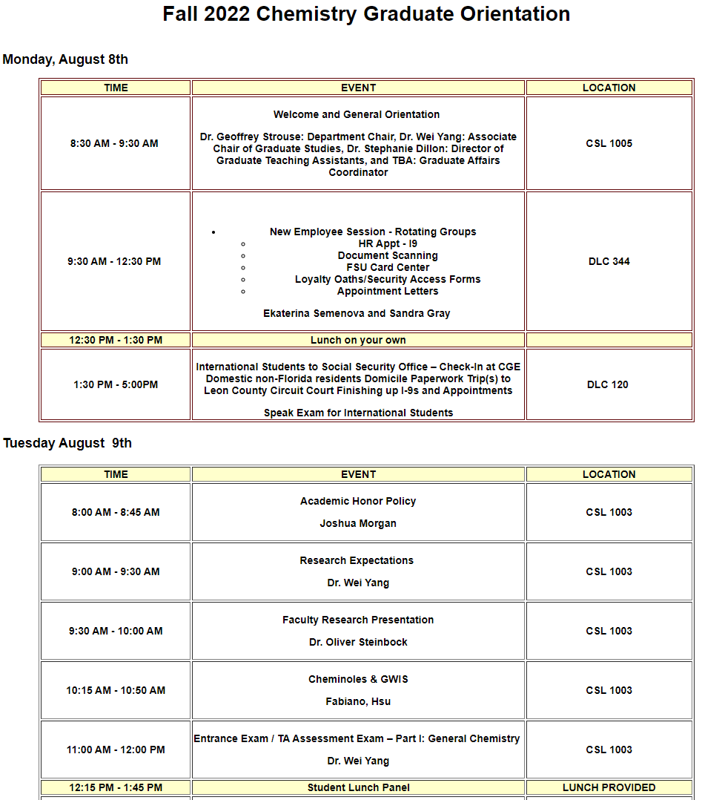
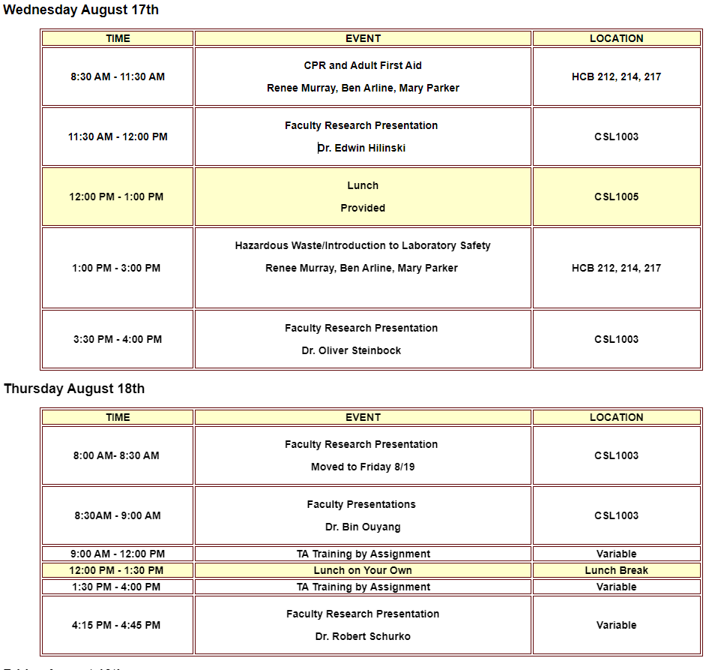
Ph.D at FSU: Timeline
1st weeks Orientation
Intake paperwork
Safety Training
TA Training
Teaching Tips
Faculty Research Presentations
and more…

Slide 27
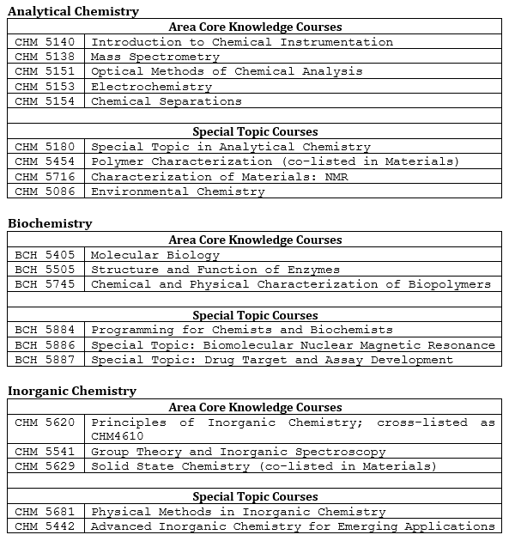
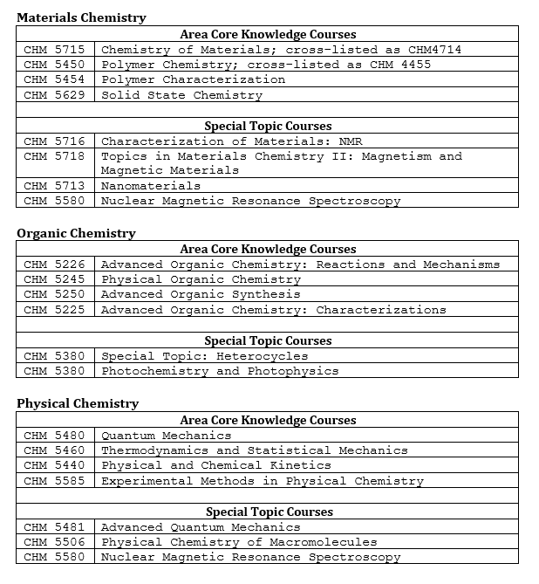
Ph.D at FSU: Timeline
1st Year 5 Classes (2 or 3 per semester)
After completing 5 classes, research focused!

Slide 28
Ph.D at FSU: Timeline
1st Sem. Lab Exploration and Choosing an Advisor
Phase 1) Meet with at least 3 faculty members. (by end of Sept.)
Phase 2) Do 2 or 3 lab explorations. (by end of Oct.)
Phase 3) Group selection.
(by start of Nov.)

Slide 29
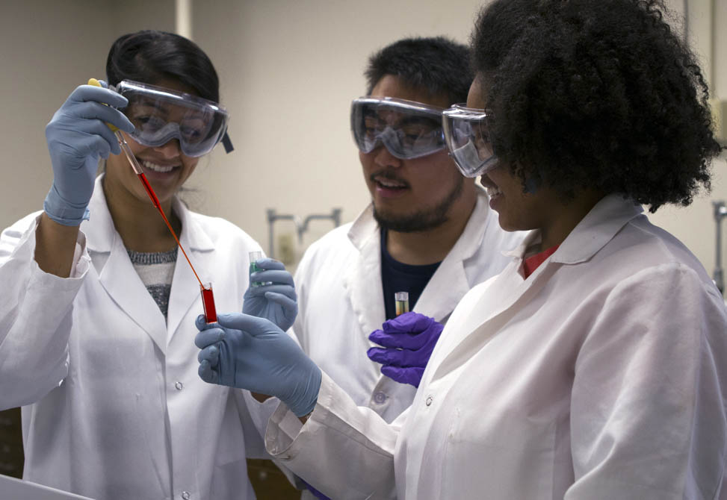
Ph.D at FSU: Timeline
1st Year Teaching Assistant
Laboratory TA
Recitation TA
Monitor 2-3 labs per week.
Office hours + lab grading.
3 x 1 hour classroom periods.
Office hours + exam grading.

Slide 30
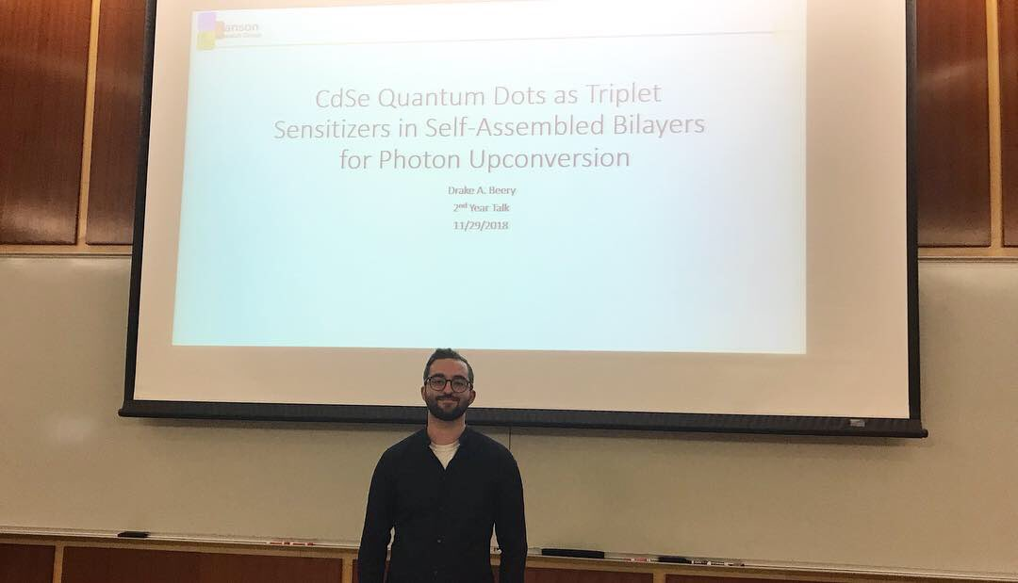
Ph.D at FSU: Timeline
2nd Year Research Presentation
Area seminar (open to all)
20-minute presentation
5-10 minutes for questions
Introduction to your research.
Some preliminary results.

Slide 31
Ph.D at FSU: Timeline
3rd Year (Fall) Ph.D. candidacy exam
Candidacy Exam (only committee members):
Written Component (i.e., Research Proposal)
<12 pages
style of an NSF or NIH R01 proposal
aims, rationale, background, preliminary data,
and future work for the Ph.D.
Oral Component (~90 min. presentation; then questions)
(a) Defense of research proposal (30-40 min.)
(b) Defense of fundamental knowledge in chemistry
After you pass, you are officially a Ph.D. candidate!
(and receive your M.S. if you want it)

Slide 32
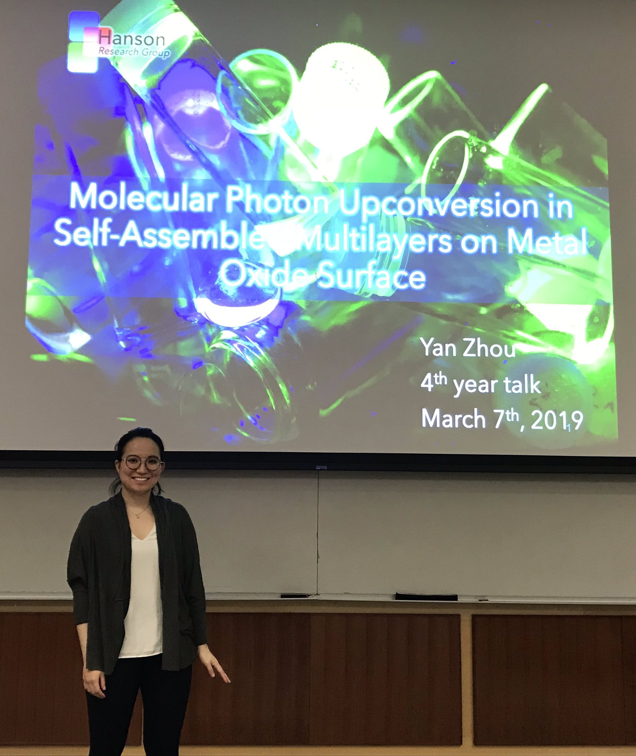
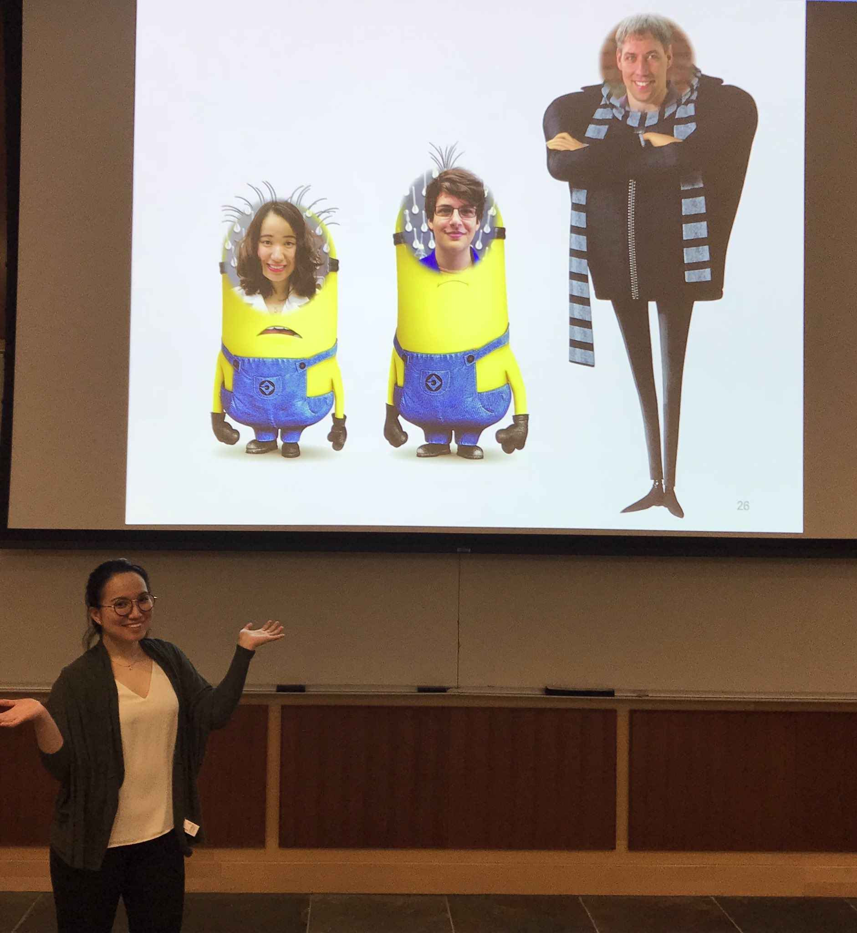
Ph.D at FSU: Timeline
4th Year Data Defense
“The Data Defense will demonstrate to the Ph.D. committee that the Ph.D. candidate has collected sufficient data of adequate quality to assemble the dissertation.”
Area seminar (open to all)
40-50 minute presentation
10-20 minutes for questions

Slide 33
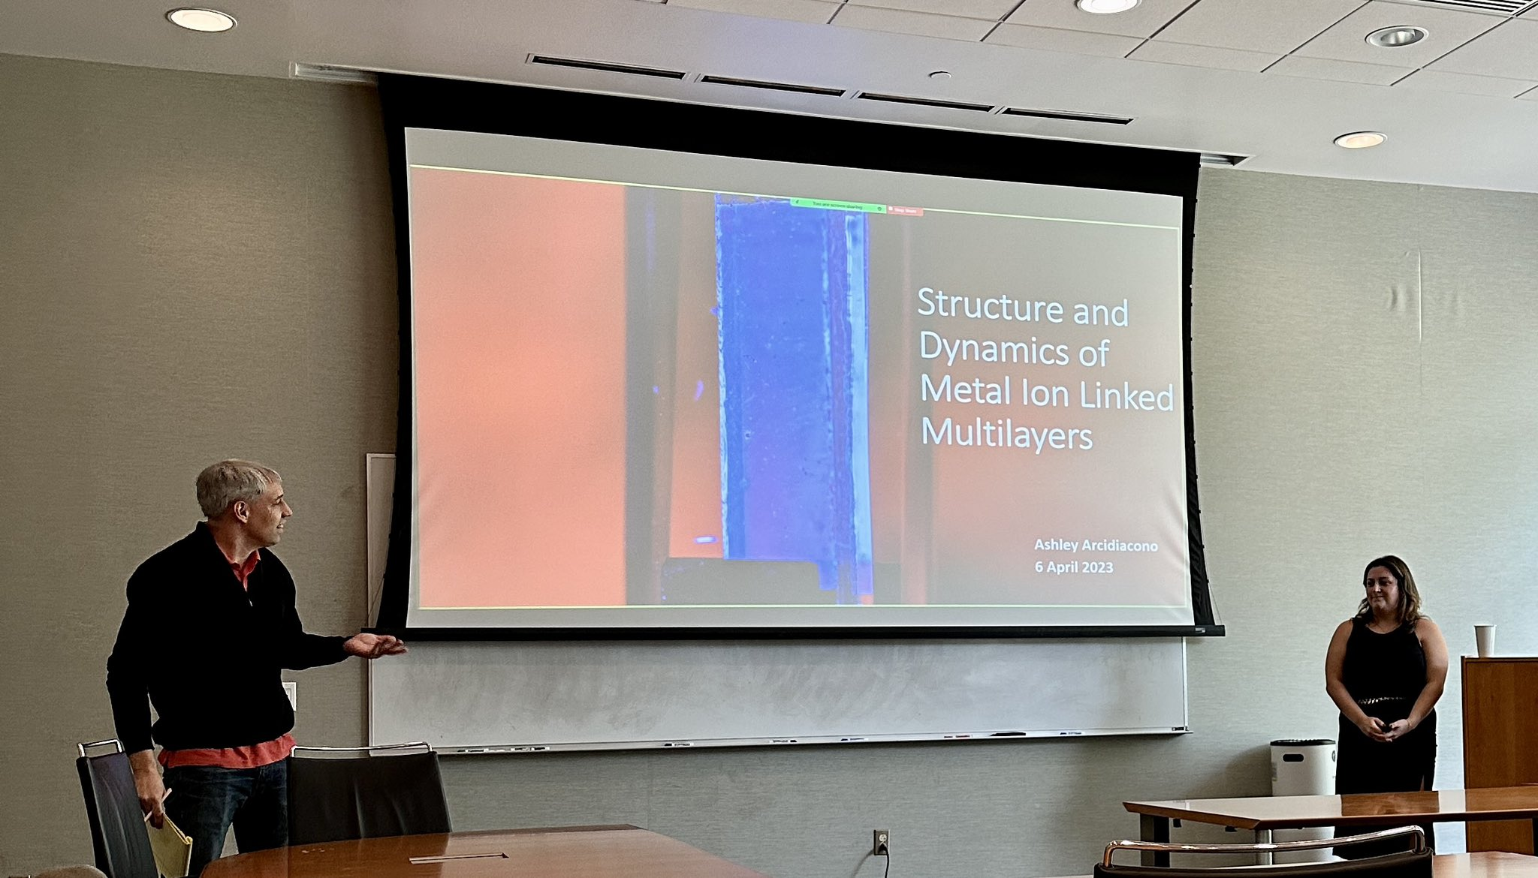
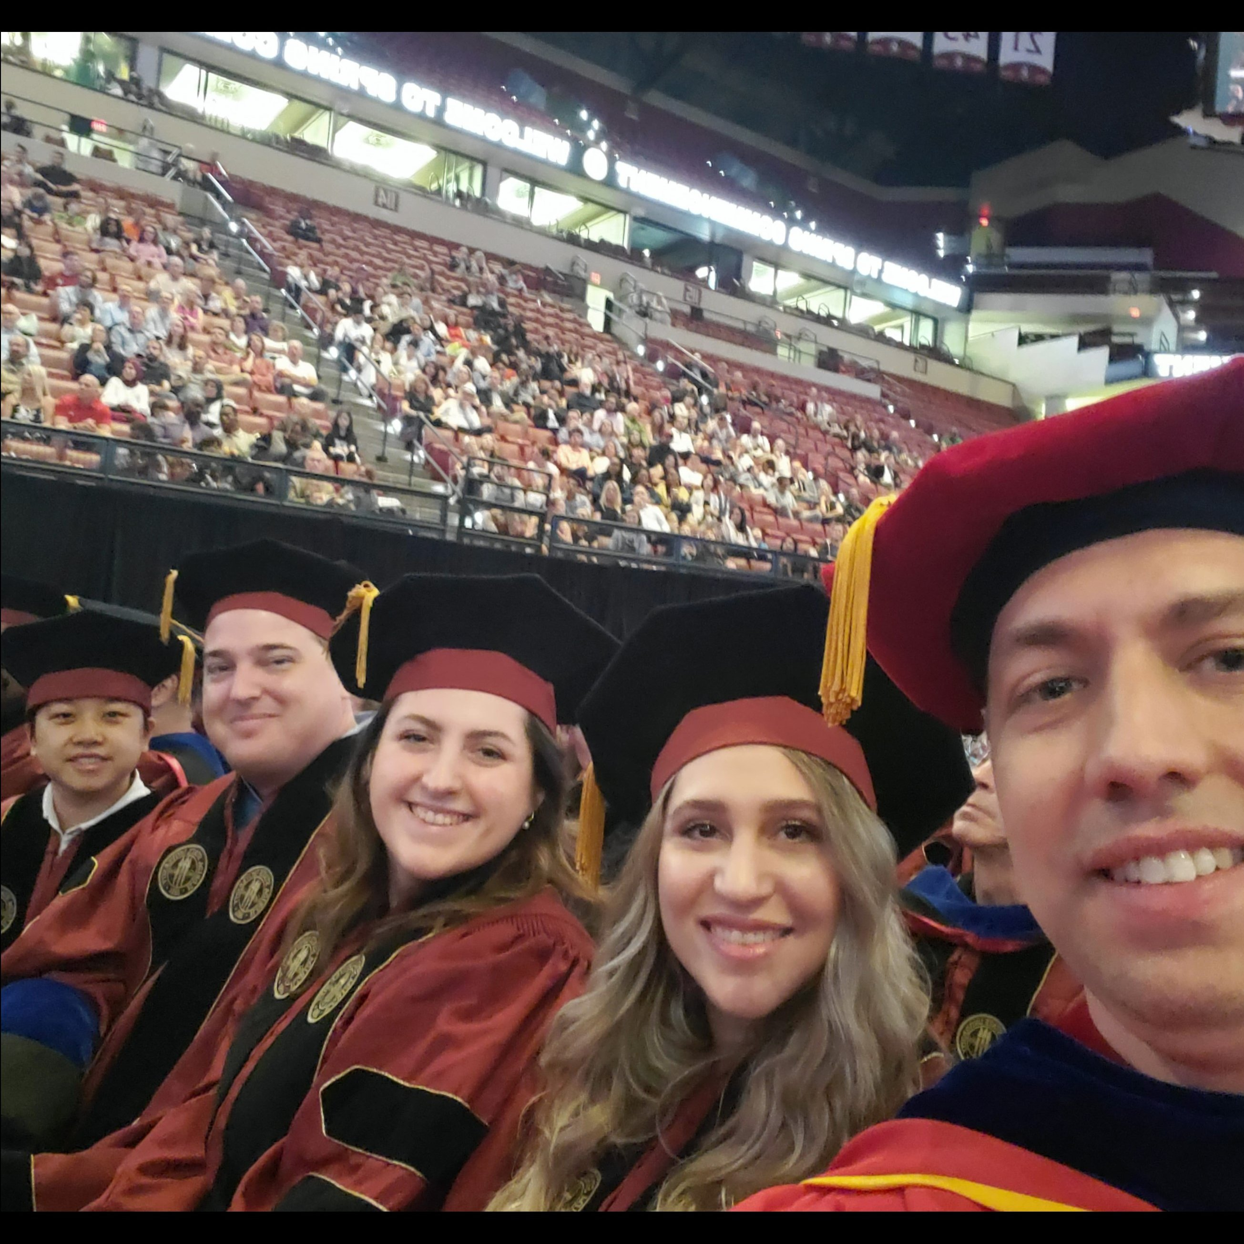
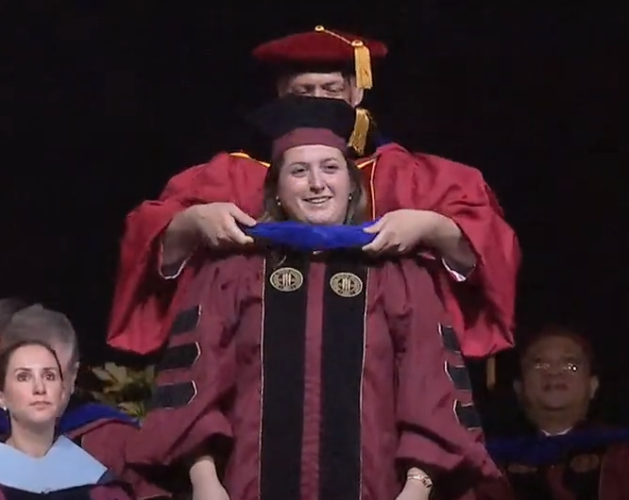
Ph.D at FSU: Timeline
4th-6th Year Thesis and Defense (average 5.2 years)
Thesis/Dissertation:
A compilation of your graduate research
Highlights a unique contribution to science
Typically, 100-300 pages
Defense:
Open, 50 min presentation
10 min. for ? from audience
30-60 min. ? from the committee

Slide 34
Ph.D at FSU: Timeline
1st weeks Orientation
1st Year 5 Classes
1st Sem. Lab Exploration and Choosing an Advisor
1st Year Teaching Assistant
2nd Year Research Presentation
3rd Year Ph.D. candidacy exam
4th Year Data Defense
4th-6th Year Thesis and Defense (average 5.2 years)

Slide 35
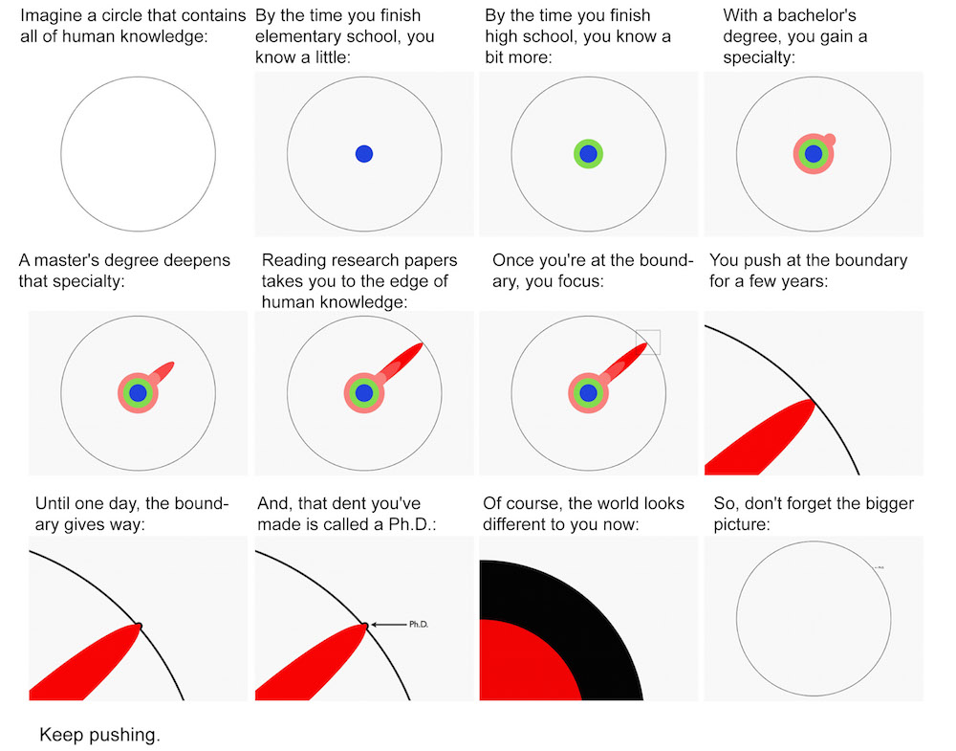
The Illustrated Guide to a Ph.D.
Matthew Might, University of Utah

Slide 36
Ph.D at FSU: Afterwards
Industry
AstraZeneca, Hercules, Vertex Pharmaceuticals, Amgen, Applied Biosystems, ThermoFinnigan, Nanostream, Ashland Chemical, PE Biosystems, Hoffman La Roche, General Dynamics, Bruker, DuPont CR&D, Merck, Pfizer, Johnson & Johnson, Waters, Rhône-Poulenc, Abbott Labs, Eli Lily, Varian NMR Inc.…
Government
Scripps Fla., Batelle Pacific Northwest Nat’l Labs, NHMFL, Wright-Patterson AFB…
Academia:
MIT, U. of Michigan, U. of Minnesota, UC Irvine, U. of Maine, École Polytechnique, Albert Einstein College of Medicine, Cornell University, Georgia State, Univ. at Alabama at Huntsville, Univ. of Maryland…
Postdoctoral positions:
MIT, Cambridge, Caltech, Northwestern, NIH, …

Slide 37
Graduate School Demystified: Outline
1) Application timeline
2) Deciding where to apply
3) The application/admission process
4) Graduate school timeline
5) Pushing the boundaries of knowledge
6) After your Ph.D.
Questions?

